Slide 1
Machine Learning Practical -1 Artificial Neural Network (ANN)
Lecturer:
Dr Hamid Khayyam (Australia)
Email: hamid.khayyam@rmit.edu.au

Slide 2
Machine learning definition and terms
Machine Learning: use computational methods to “learn” information directly from data without relying on a predetermined equation as a model.
Machine learning algorithms:
Supervised :
Classification: Discrete values output (e.g. 0 or 1, red, blue or green)
Regression: Predict continuous values output (e.g. price, temperature)
Unsupervised (outside course scope) :
Clustering
Reference : H. Khayyam, G. Golkarnaranji, R. Nakhaie Jazar, (2017) “Limited Data Modelling Approaches for Engineering Applications”, Nonlinear Approaches in Engineering Applications, 978-3-319-69479-5, International publication Springer, (2017) .

Slide 3

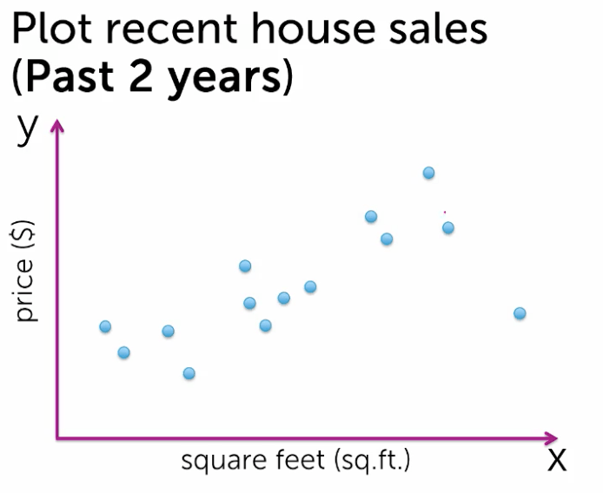

Examples of supervised and unsupervised learning
Email classification: supervised learning
House sale prediction(regression): supervised learning
Google news grouping(clustering): unsupervised learning

Slide 4
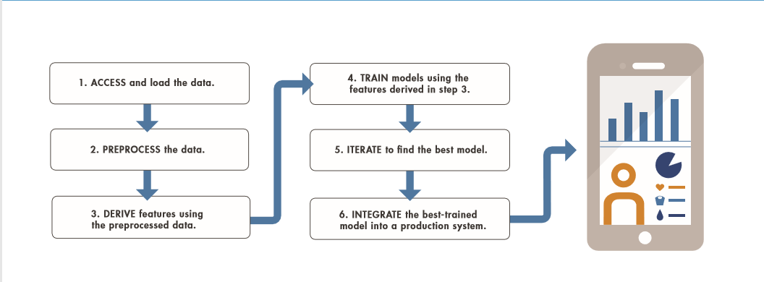
Work flow for machine learning

Slide 5
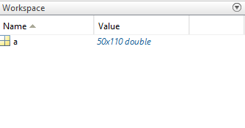
1. Access and load the data
Load variables from file into workspace
Syntax:
load filename.mat or load('filename.mat');
Example:
Clear;clc;
a=rand(50,110); % create random data
save('output.mat','a'); % save variable in the output.mat file
clear; % clear the workspace
load('output.mat'); % load output.mat file

Slide 6

1. Access and load the data (cont.)
Read Microsoft Excel spreadsheet file
Syntax:
Matlab functions
filename = 'file1.xlsx';
sheet='Sheet1';
xlRange = 'A2:B4';
num = xlsread(filename);
num = xlsread(filename,sheet,xlRange);
Filename
Variables
Sheet
xlRange: a specific range in Excel syntax such as:'A2:B4'

Slide 7
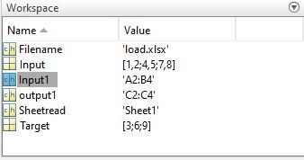
1. Access and load the data (cont.)
Example:
clc;
clear;
Filename='load.xlsx';
Sheetread='Sheet1';
Input1='A2:B4';
output1='C2:C4';
Input=xlsread(Filename,Sheetread,Input1); %Read Microsoft Excel
Target=xlsread(Filename,Sheetread,output1 );
x=Input;
t=Target;

Slide 8
1. Access and load the data (cont.)
Example : Create an Excel file named load2.xlsx with P as inputs and T as an output.
24 42
26 48
32 105
35 58
45 120
50 20
100 30
54 32
123 60
30 110
110 28
75 18
105 45
65 22
25 18
20 100
40 80
20 105
16 25
70 18
87
351
483
329
350
300
359
320
309
339
320
300
389
340
311
439
379
483
320
291
P =
T =

Slide 9
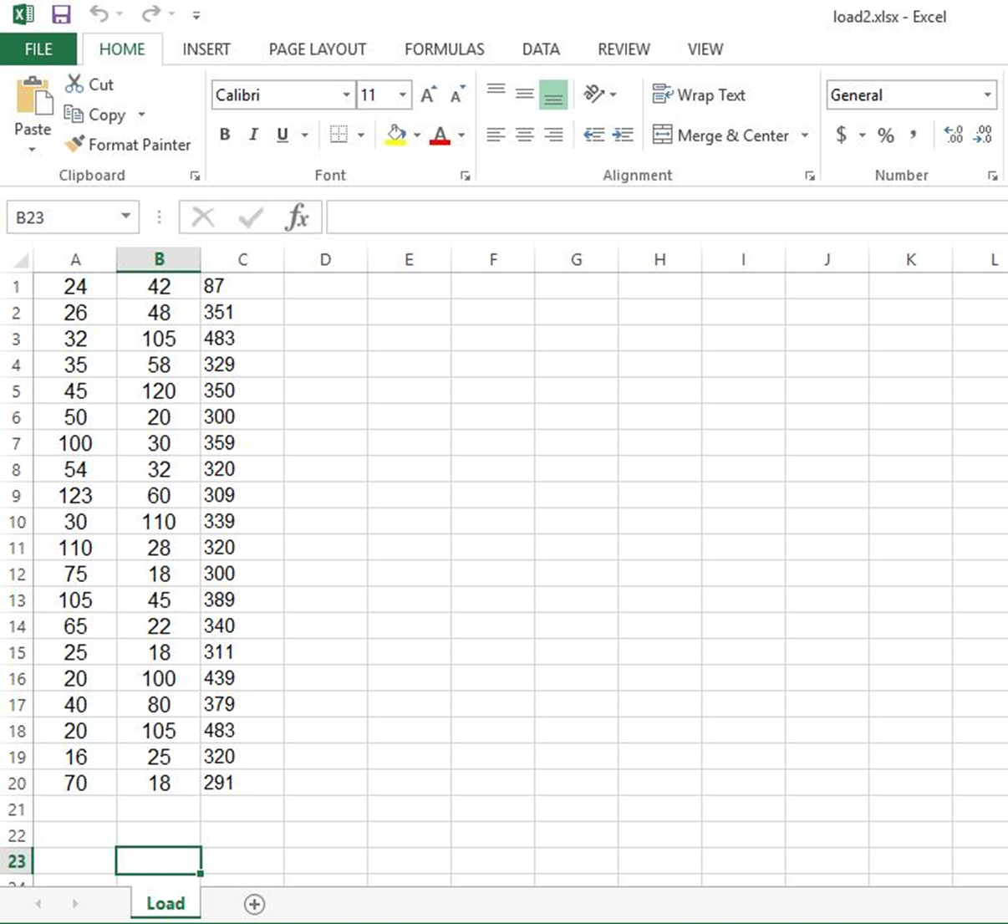
1. Access and load the data (cont.)
P
T

Slide 10
1. Access and load the data (cont.)
clc;
clear;
Filename='load2.xlsx';
Sheetread='load';
Input1='A1:B20';
output1='C1:C20';
x=xlsread(Filename,Sheetread,Input1);
t=xlsread(Filename,Sheetread,output1 );

Slide 11
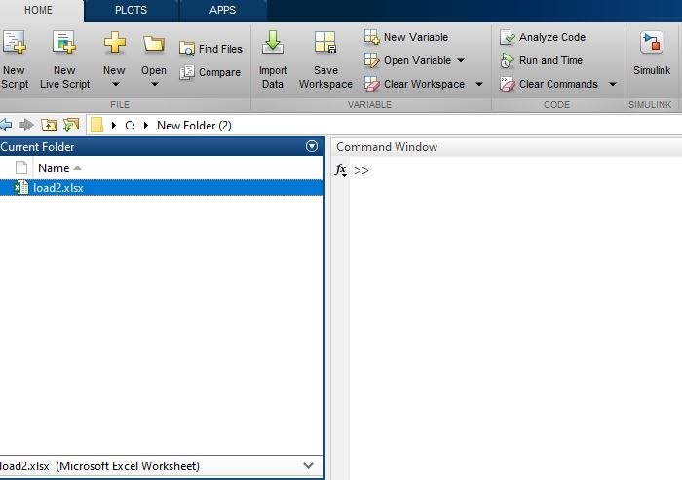
1. Access and load the data (cont.)
It is the same than xlsread!
Importing Spreadsheet(load2.xlsx) into MATLAB using import data

Slide 12
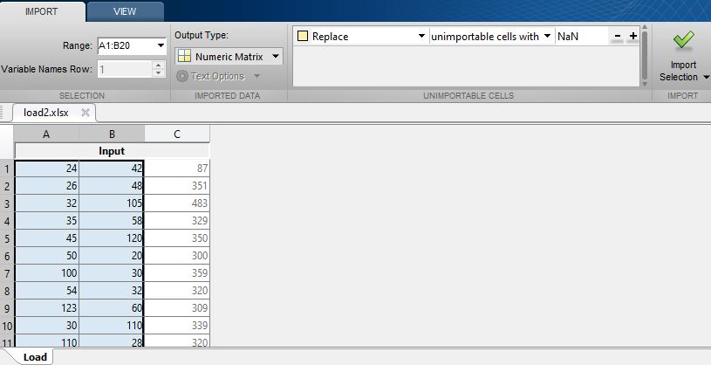

1. Access and load the data (cont.)
It is the same than xlsread!
Importing Spreadsheet(load2.xlsx) into MATLAB using import data

Slide 13
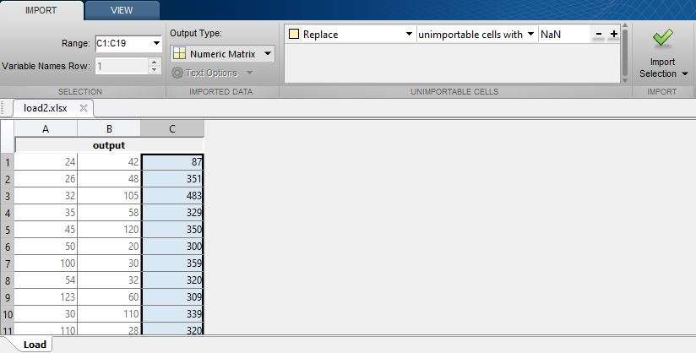
1. Access and load the data (cont.)
It is the same than xlsread!
Importing Spreadsheet(load2.xlsx) into MATLAB using import data

Slide 14
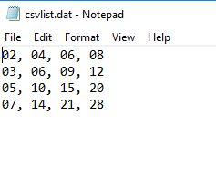
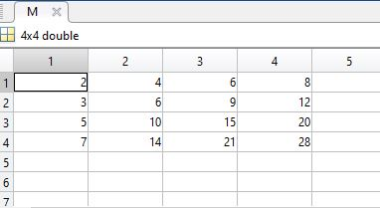
1. Access and load the data (cont.)
Read comma-separated value (CSV) file or text files
Syntax:
Example :
csvlist.dat(Create a file named csvlist.dat in notepad that contains following comma-separated values)
02, 04, 06, 08
03, 06, 09, 12
05, 10, 15, 20
07, 14, 21, 28
M = csvread(filename);
clear;
clc;
filename ='csvlist.dat';
M = csvread(filename);

Slide 15
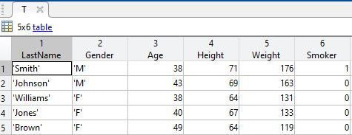
1. Access and load the data (cont.)
Create table from File
Syntax:
Example:
clear;
clc;
filename = 'myCsvTable.dat';
T = readtable(filename);
T = readtable(filename);

Slide 16


2. Data pre-processing
Find Missing data (NaN,missing)
Syntax:
T1= isnan(x); % x is the input data (e.g. vector,matrix,table )
T2= ismissing(x);
Example:
clear;clc;
x = [NaN 1 2 3 4]; % NaN:Not-a-Number;
T1= isnan(x);
T2= ismissing(x);
Replace or and Ignore missing Data
Syntax:
xReplace = fillmissing(x,method); % Replace
xRemove = rmmissing(x); % Remove
Method:
'previous' previous non-missing value
'next' next non-missing value
'nearest' nearest non-missing value
'linear' linear interpolation of neighbouring
'spline' piecewise cubic spline interpolation

Slide 17
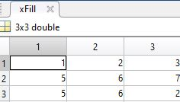
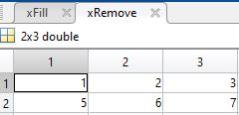
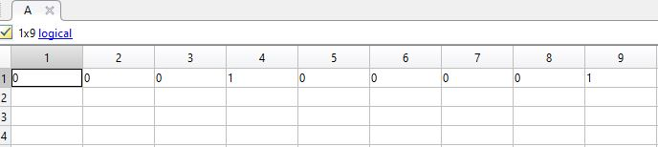
2. Data pre-processing (cont.)
Example :
clear;clc;
x =[1 2 3 ;5 6 7;NaN NaN 2];
xFill= fillmissing(x,'previous');
xRemove = rmmissing(x);
Find and replacing outliers
Syntax:
xoutlier = isoutlier(x); % x is the input data (e.g. vector,matrix,table )
Example:
clear;clc;
x = [57 59 60 100 59 58 57 58 300];
A = isoutlier(x);

Slide 18
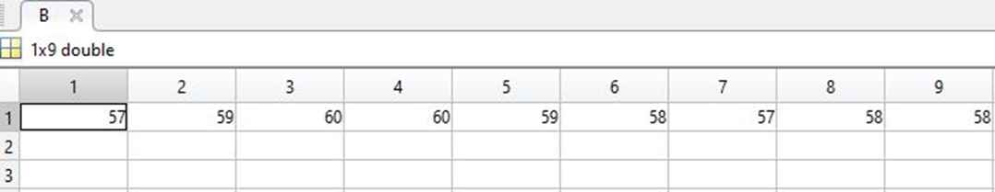
2. Data pre-processing (cont.)
Replace or and Ignore outliers
Syntax:
B = filloutliers(x,method);
Method:
'previous' previous non-missing value
'next' next non-missing value
'nearest' nearest non-missing value
'linear' linear interpolation of neighbouring
'spline' piecewise cubic spline interpolation
Example :
clear; clc;
x = [57 59 60 100 59 58 57 58 300];
B = filloutliers(x, 'previous');

Slide 19
2. Data pre-processing (cont.)
Data normalization and standardization
To change the range of the values to be between a specific range ( e.g. range [-1,1] or [0,1]) .
To avoid the values with large values to dominate the results.
To equalize the contribution of all the inputs.
Data normalization:
x_new = (x - x_min)/(x_max - x_min )
Description:
x is the input data; x_min is the minimum of x; x_max, the maximum of x.
x_min = min(x) % To obtain the minimum of x
x_max = max(x) % To obtain the maximum of x
Data standardization:
x_new = (x - μ)/σ
Description:
x is the input data; μ is the mean(average) ; σ is the standard deviation.
μ = mean(x) % To obtain the mean value
σ = std(x) % To obtain the standard deviation

Slide 20
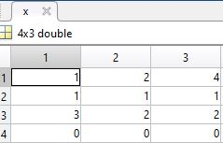
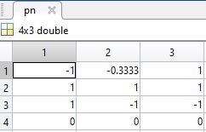
2. Data pre-processing (cont.)
Data standardization in Matlab:
Syntax:
[Y,PS] = mapminmax(X,YMIN,YMAX);
Description:
Process matrices by mapping row minimum and maximum values to [-YMIN YMAX]
X: is the input.
YMIN : is the minimum value (Default: -1).
YMAX : is the maximum value (Default :1).
Y :is the output.
PS: is the process setting.
Example :
clear; clc;
x = [1 2 4; 1 1 1; 3 2 2; 0 0 0];
[pn,ps] = mapminmax(x);
x_again = mapminmax('reverse', pn,ps); % To reverse

Slide 21
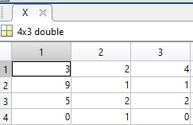
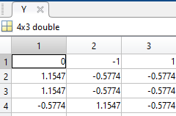

2. Data pre-processing (cont.)
Data normalization in Matlab:
Syntax:
[Y,PS] = mapstd(X,ymean,ystd) ;
Description:
Process matrices by mapping each row’s means to 0 and deviations to 1.
X: is the input.
ymean: is the mean value for each row of Y(Default: 0).
ystd : is the standard deviation for each row of Y(Default :1).
Y :is the output.
PS: is the process setting.
Example:
clear;clc;
X = [3 2 4; 9 1 1; 5 2 2; 0 1 0];
[Y,PS] = mapstd(X);
X_again = mapstd('reverse',Y,PS); % To reverse

Slide 22
3. Feature selection and Dimensionality reduction
Removing redundant or irrelevant features(inputs)
Combining features
Creating new features
Common technique
Principal component analysis (PCA) (outside course scope)
Description:
Detects linear dependencies between variables and replaces groups of correlated variables by new uncorrelated variables, the principal components (PCs).

Slide 23
The Steps of an application of Artificial Neural Network (ANN)
Data pre-processing
[Y,PS] = mapstd(X,ymean,ystd) ;
Selecting network architecture
net = feedforwardnet();
Network training
[net,tr]= train(net,inputs,targets);
Simulation (validation)
a =net (inputs);
Performance(Post-processing)
MSE: Mean squared error performance function.
RMSE: Root Mean squared error performance function
R: Coefficient of correlation.
R²: Coefficient of determination (R-squared).

Slide 24
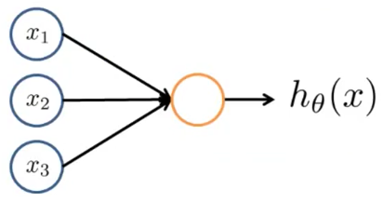
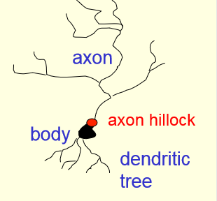
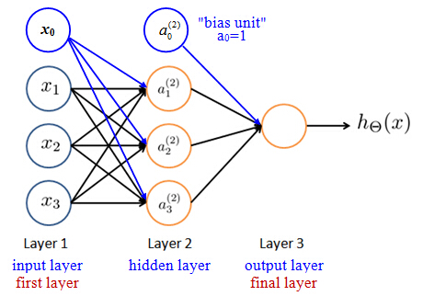
4. Build and train the models (ANN)

Slide 25
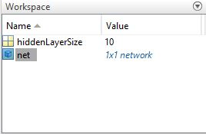
4. Build and train the models (ANN) (cont.)
Building neural network
Syntax:
net = patternnet(hiddenLayerSize);
net = fitnet(hiddenLayerSize);
net = feedforwardnet (hiddenLayerSize);
Description :
hiddenLayerSize: number of neurons in the hidden layer .
fitnet: regression and curve-fitting.
patternnet: classification and pattern-recognition.
feedforwardnet: is the generalized form of fitnet and patternnet.
Example:
clear;clc;
hiddenLayerSize = 10;
net = fitnet(hiddenLayerSize);

Slide 26
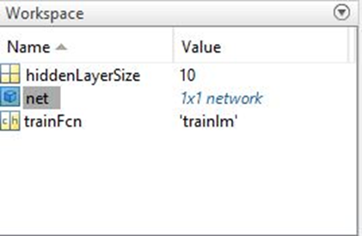

4. Build and train the models (ANN) (cont.)
Choose a Training Function :
'trainlm' Levenberg-Marquardt backpropagation (fastest algorithm and the most common method).
'trainbr' Bayesian Regulation backpropagation.
'trainscg' Scaled conjugate gradient backpropagation (better in classification problems).
'traingd' Gradient descent backpropagation.
Example:
trainFcn = 'trainlm';
For a list of all training functions type: help nntrain
Example:
clear;clc;
hiddenLayerSize = 10;
trainFcn = 'trainlm';
net = feedforwardnet(hiddenLayerSize, trainFcn);

Slide 27
4. Build and train the models (ANN) (cont.)
Setup Division of Data for Training, Validation, Testing
dividerand : Partition indices into three sets using random indices.
divideblock: Partition indices into three sets using blocks of indices.
Example:
net.divideFcn = 'dividerand';
net.divideFcn = 'divideblock';
A list of all data division functions type: help nndivision
net.divideMode : defines the target data dimensions which to divide up when the data division function is called.
net.divideMode = 'sample'; % Static networks
net.divideMode = 'time'; % Dynamic networks
Example:
net.divideMode = 'sample'; % Divide up every sample
net.divideParam.trainRatio = 70/100;
net.divideParam.valRatio = 15/100;
net.divideParam.testRatio = 15/100;

Slide 28
4. Build and train the models (ANN) (cont.)
Choose plot Functions:
ploterrhist : plot error histogram
plotperform : plot network performance
plottrainstate : plot training state values
plotregression: plot linear regression
Example:
net.plotFcns = {'plotperform','plottrainstate','ploterrhist', 'plotregression'};
plotperform();
plottrainstate();
ploterrhist();
plotregression ();

Slide 29
4. Build and train the models (ANN) (cont.)
Choose Activation functions
Linear: 'purelin'
Sigmoid or Logistic: 'logsig'
Tanh ( Hyperbolic tangent): 'tansig'
A list of all transfer(activation) functions type: help nntransfer
Hidden layer activation function
Sigmoid, Tanh and Relu (Deep learning )
Output layer activation function
Regression: linear
Classification: softmax % simple sigmoid works too but softmax works better
Example:
net.layers{1}.transferFcn = 'logsig'; % for hidden layer
net.layers{2}.transferFcn = 'purelin' ; % for output layer

Slide 30
4. Build and train the models (ANN) (cont.)
Choosing number and size of the layers
Example:
net.numLayers = 3; % number of layers in the network
net.layers{1}.size = 8; % number of neurons
Choose training parameters
net.trainParam.mu=0.005 % Marquardt adjustment parameter (trainlm and trainbr)
net.trainParam.lr=0.05 % learning rate (traingd)
net.trainParam.epochs=1000 % max epochs
net.trainParam.goal=1e-5 % minimum performance value
net.trainParam.time=60 % maximum training time in seconds
Choose a Performance Function
MSE : Mean squared error performance function.
SSE: Sum squared error performance function.
Example:
net.performFcn = ‘mse';
A list of all performance functions type: help nnperformance

Slide 31
4. Build and train the models (ANN) (cont.)
Example of different parameter settings in ANN
clear;clc;
trainFcn = 'trainlm'; hiddenLayerSize = 10;
net = fitnet(hiddenLayerSize,trainFcn); %fitnet for regression
net.divideFcn = 'dividerand'; %data division
net.divideMode = 'sample'; %static network
net.divideParam.trainRatio = 70/100; % Divide up every sample
net.divideParam.valRatio = 15/100;
net.divideParam.testRatio = 15/100;
net.plotFcns = {'plotperform','plottrainstate','ploterrhist'};
net.layers{1}.transferFcn = 'logsig'; %for hidden layer
net.layers{2}.transferFcn = 'purelin'; %for output layer

Slide 32
4. Build and train the models (ANN) (cont.)
net.trainParam.mu=0.005 % Marquardt adjustment parameter
net.trainParam.epochs=1000 % max epochs
net.trainParam.max_fail=6; % Maximum validation failure
net.trainParam.goal=1e-5 % minimum performance value
net.trainParam.time=60 % maximum training time in seconds
net.performFcn = 'mse'; % Performance function

Slide 33
4. Build and train the models (ANN)
Train: train neural network
Syntax :
[net,tr] = train(net,x,t); % net: newly trained network; % tr: training record
Example : % The answers may vary due to randomness%
clear;
clc;
x = [0 1 2 3 4 5 6 7 8];
t = [0 0.84 0.91 0.14 -0.77 -0.96 -0.28 0.66 0.99];
net = feedforwardnet(10);
net = train(net,x,t);

Slide 34
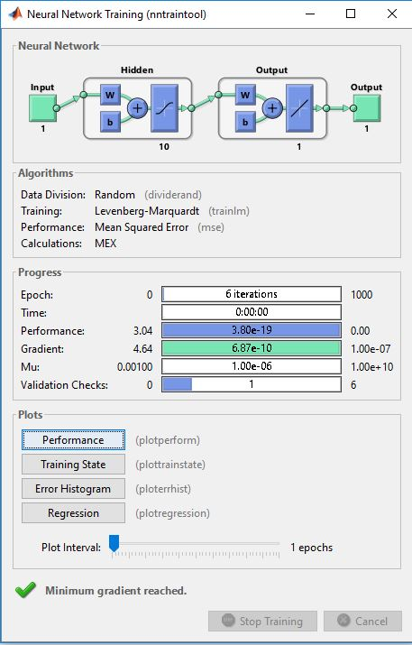
4. Build and train the models (ANN) (cont.)

Slide 35
5. Validation and performance (ANN)
Test the network (validation)
Syntax:
y=net(x); % x is the input , y is the predicted output based on input x.
Example:
clear;clc;
x = [0 1 2 3 4 5 6 7 8];
t = [0 0.84 0.91 0.14 -0.77 -0.96 -0.28 0.66 0.99];
plot(x,t,'o'); % plot data
net = feedforwardnet(10); % Build the network
net.divideParam.trainRatio = 60/100; % Divide the data
net.divideParam.valRatio = 20/100;
net.divideParam.testRatio = 20/100;
RandStream.setGlobalStream (RandStream ('mrg32k3a'));
% Just for the sake of reproducing the same results in the slides.
net = train(net,x,t); % Train the data
y = net(x); % Validation
plot(x,t,'o',x,y, '*'); % plot t(actual output) versus y (predicted output)

Slide 36
t ( actual out put shown with o) versus y (predicted output shown with *)

Slide 37
5. Validation and performance (ANN) (cont.)
Example1: % Example1.xlsx is imported %
clear;
clc;
load x.mat;
load t.mat;
x=x'; % Transpose Input
t=t'; % Transpose Output
net = feedforwardnet(10);
%net.divideFcn = 'dividerand'; % Divide data randomly
RandStream.setGlobalStream (RandStream ('mrg32k3a'));
[net,tr] = train(net,x,t); % train the network
figure, plotperform(tr); % performance plot
figure, plottrainstate(tr); % training state plot
y=net(x); % Test the network

Slide 38
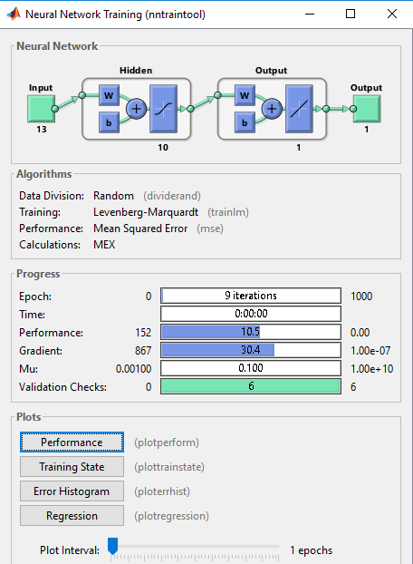
Neural Network Training

Slide 39
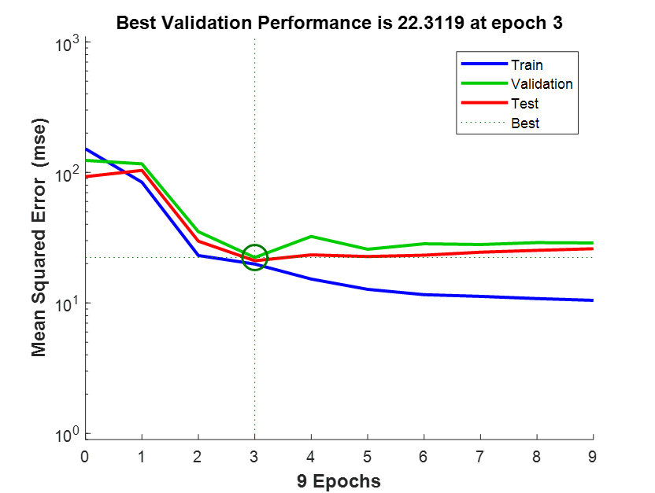
Plotperform
Plottrainstate

Slide 40
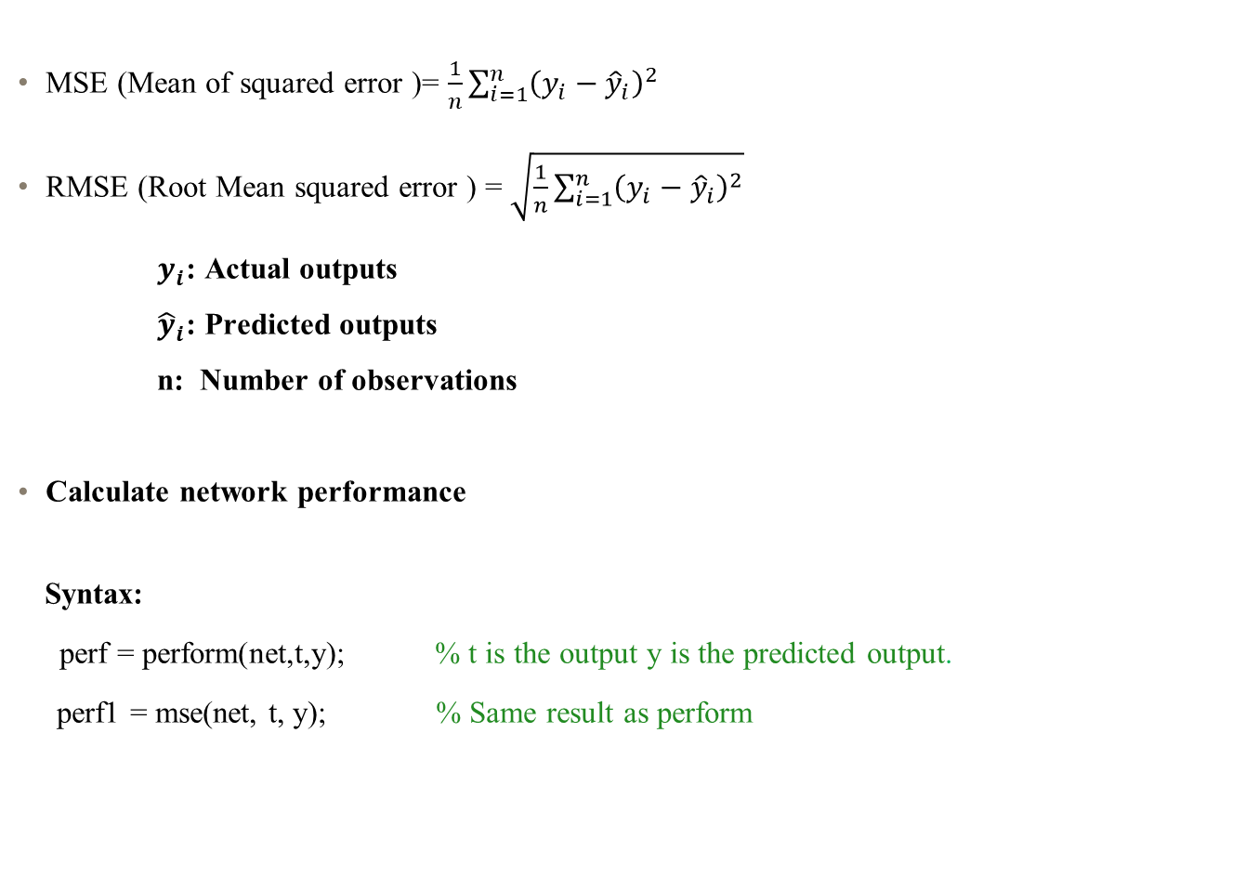
5. Validation and performance (ANN) (cont.)
MSE (Mean of squared error )= $\frac{1}{n}\sum_{i=1}^{n}{{\left(y_{i}−{\hat{y}}_{i}\right)}^{2}}$
RMSE (Root Mean squared error ) = $\sqrt{\frac{1}{n}\sum_{i=1}^{n}{{\left(y_{i}−{\hat{y}}_{i}\right)}^{2}}}$
$y_{i}$: Actual outputs
${\hat{y}}_{i}$: Predicted outputs
n: Number of observations
Calculate network performance
Syntax:
perf = perform(net,t,y); % t is the output y is the predicted output.
perf1 = mse(net, t, y); % Same result as perform

Slide 41
5. Validation and performance (ANN) (cont.)
Example2: % Example2.xlsx is imported %
clear;
clc;
load x.mat;
load t.mat;
x=x'; % Transpose Input
t=t'; % Transpose Output
plot(x,t,'o');
net = feedforwardnet(20); % Build the network with 20 neurons
net.performFcn;
% Shows that MSE is the default network performance function
RandStream.setGlobalStream (RandStream ('mrg32k3a'));
net = train(net,x,t); % Train the network
y = net(x); % Validation
perf = perform(net,t,y); % perf1 = mse(net, t, y) % performance
plot(x,t,'o',x,y, '*'); % o for x versus t , * for x versus y

Slide 42
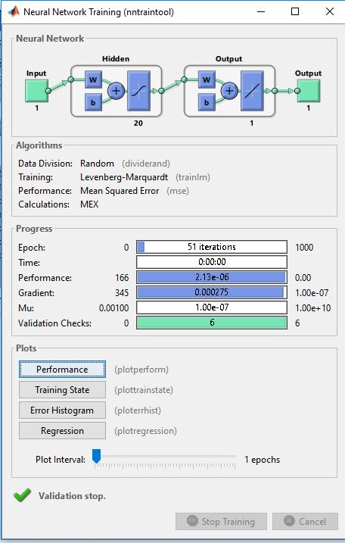
Neural Network Training

Slide 43
Plotperform
Plottrainstate

Slide 44
Plotregression

Slide 45
t ( actual output shown with o) versus y (predicted output shown with *)

